Slide 1


Slide 2
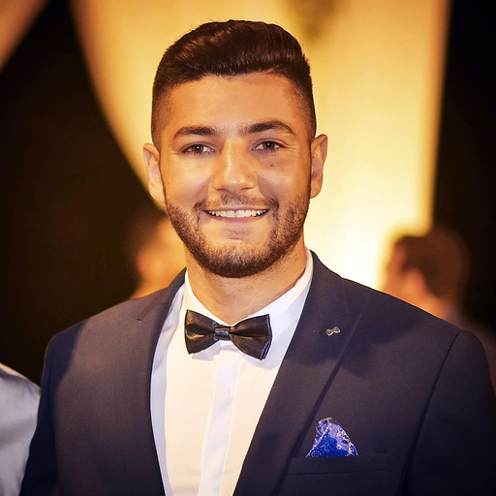
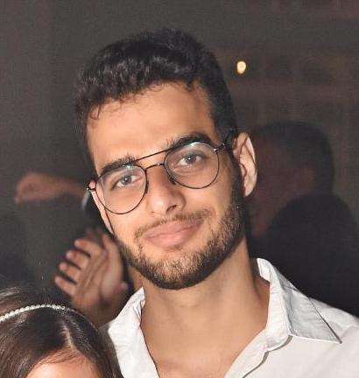

The Team
Amit Aharoni
26, Pardesiya
3rd year C.S. student
Knowledge in C#, JavaScript, C++
Sports fan, likes solving problems
GitHub: AmitAharoni
Nadav Suliman
26, Ra’anana
3rd year C.S. student
Knowledge in Java, JavaScript, HTML/CSS
Likes basketball, CTFs, Gaming
GitHub: nadavsu
Tamir Houri
26, Ramat Gan
2nd year C.S. student
Knowledge in C++, C, Python, HTML
Likes running, watching Netflix, diving
GitHub: Tamirho

Slide 3
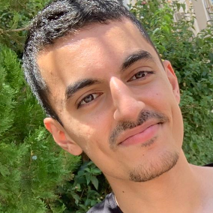

The Team
Daniel Malky
23, Holon
2nd year C.S. student
Knowledge in C, C++, Python
Likes movies & snooker
GitHub: DanielMy777
Micha Levy
24, Modi’in
2nd year C.S. student
Knowledge in C, C++
Likes watching Netflix
GitHub: Micha546

Slide 4
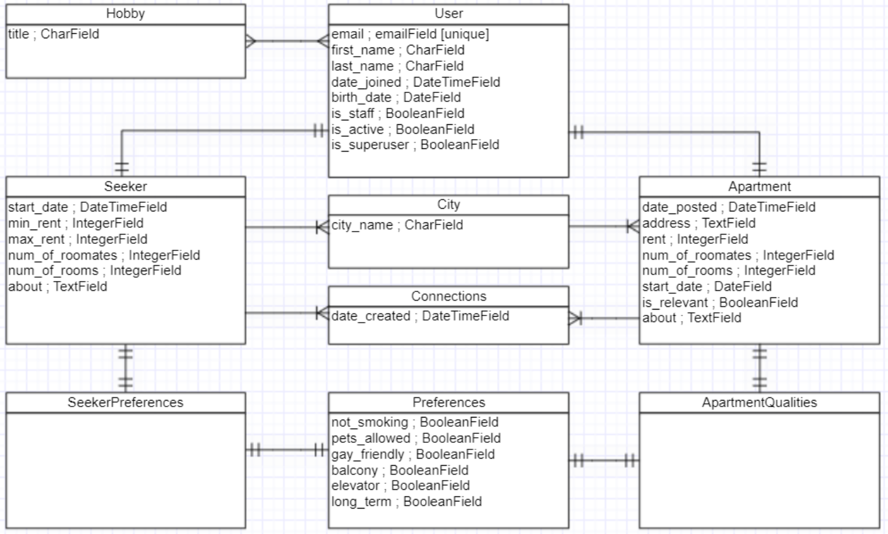
Data Model Design (ERD)

Slide 5
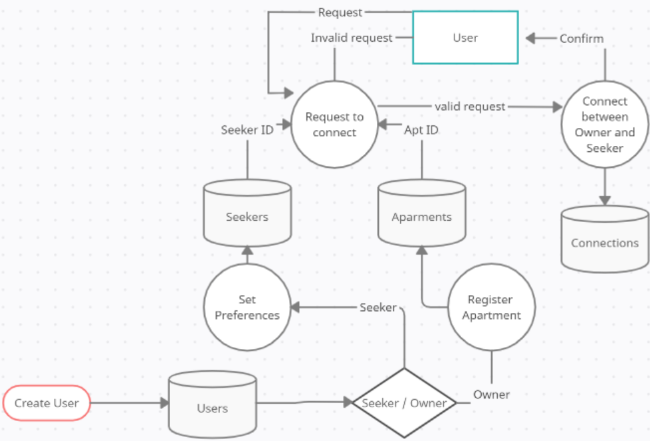
App Design – DFD

Slide 6
Features list
User management – Micha
Hobbies & matching – Nadav
Apartment management & search engine – Tamir & Amit
Contacts & connections – Daniel

Slide 7
Data Model via Django admin UI
Present through screen share

Slide 8
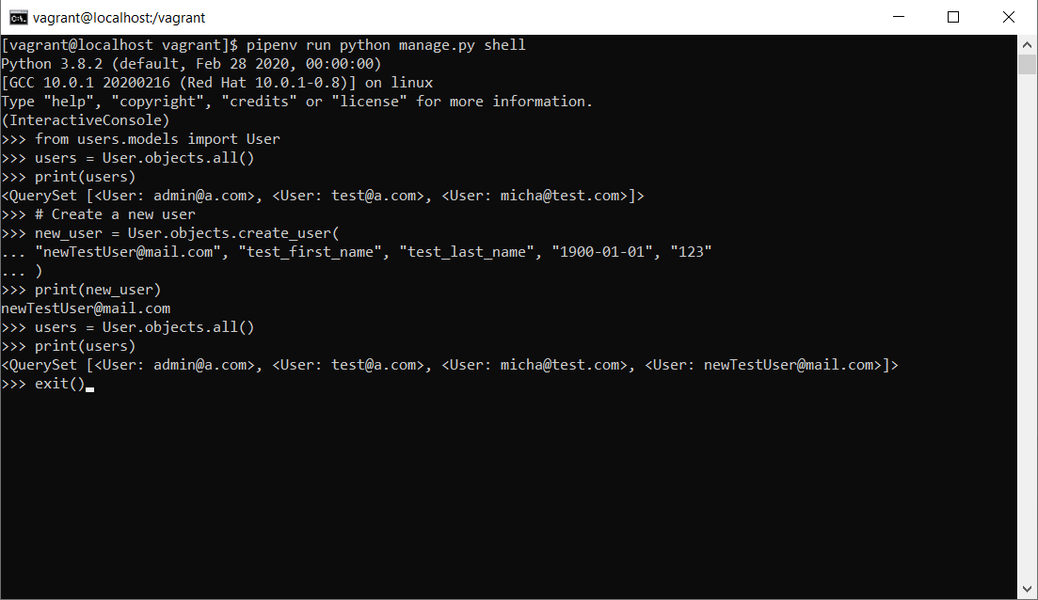
Manipulation function via Django shell - User

Slide 9
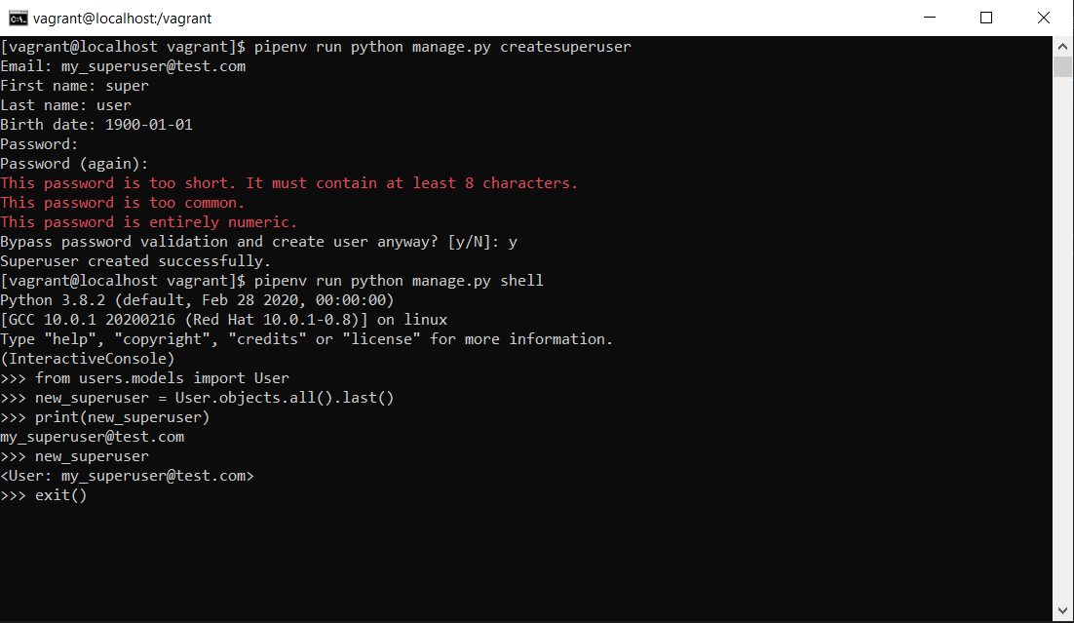
Manipulation function via Django shell - SuperUser

Slide 10
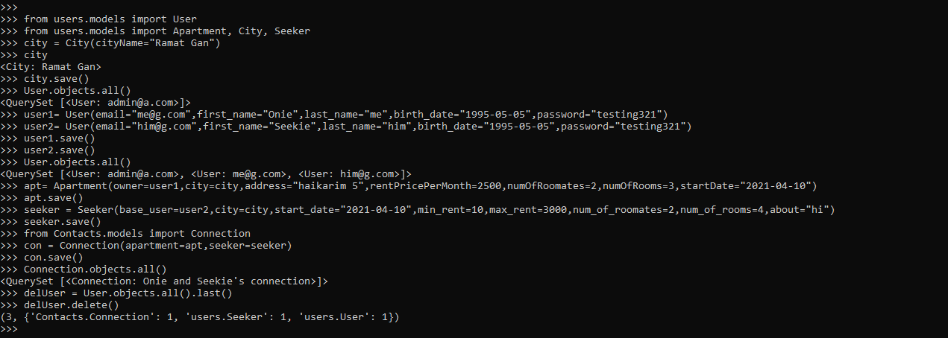
Manipulation function via Django shell – Models and Data Flow

Slide 11
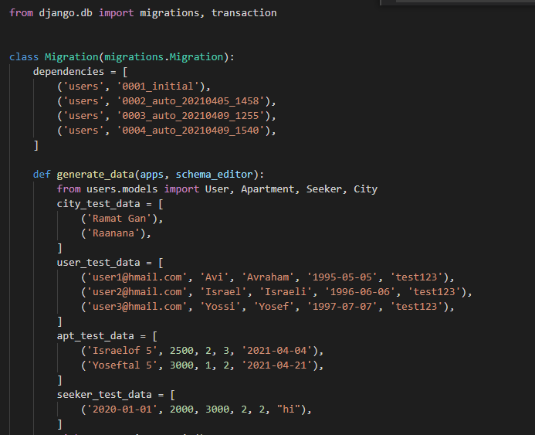
Test Data (screenshots)

Slide 12
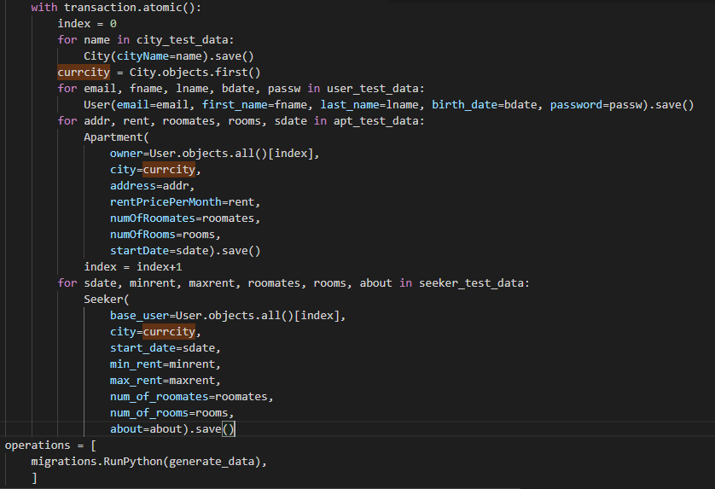
Test Data (screenshots)

